Slide 1
Unit - 3
Combinational Logic Circuits

Slide 2
Contents
Binary adder
Binary adder as subtractor
Carry look ahead adder
Decimal adder
Magnitude Comparator

Slide 3
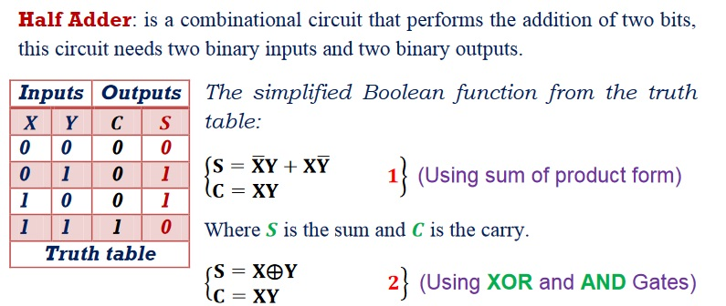
Binary adder
Binary Adder
x
y
S
C
HA

Slide 4
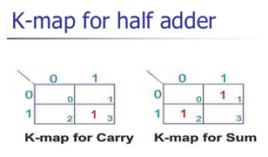
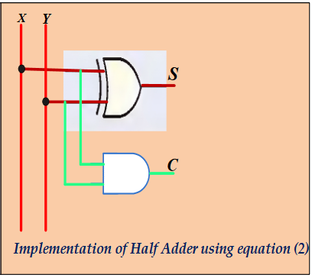

Half adder
Binary Adder
Y
Y
X
X

Slide 5
Binary Adder
Full Adder
Adds 1-bit plus 1-bit plus 1-bit
Produces Sum and Carry
x
y
z
S
C
FA
x
+ y
+ z
───
C S
x y z | C S
0 0 0 | 0 0
0 0 1 | 0 1
0 1 0 | 0 1
0 1 1 | 1 0
1 0 0 | 0 1
1 0 1 | 1 0
1 1 0 | 1 0
1 1 1 | 1 1
 |  |  |  | y
 |  | 0 | 1 | 0 | 1
x |  | 1 | 0 | 1 | 0
 |  |  | z
S = xy'z'+x'yz'+x'y'z+xyz = x ⊕ y ⊕ z
 |  |  |  | y
 |  | 0 | 0 | 1 | 0
x |  | 0 | 1 | 1 | 1
 |  |  | z
C = xy + xz + yz

Slide 6
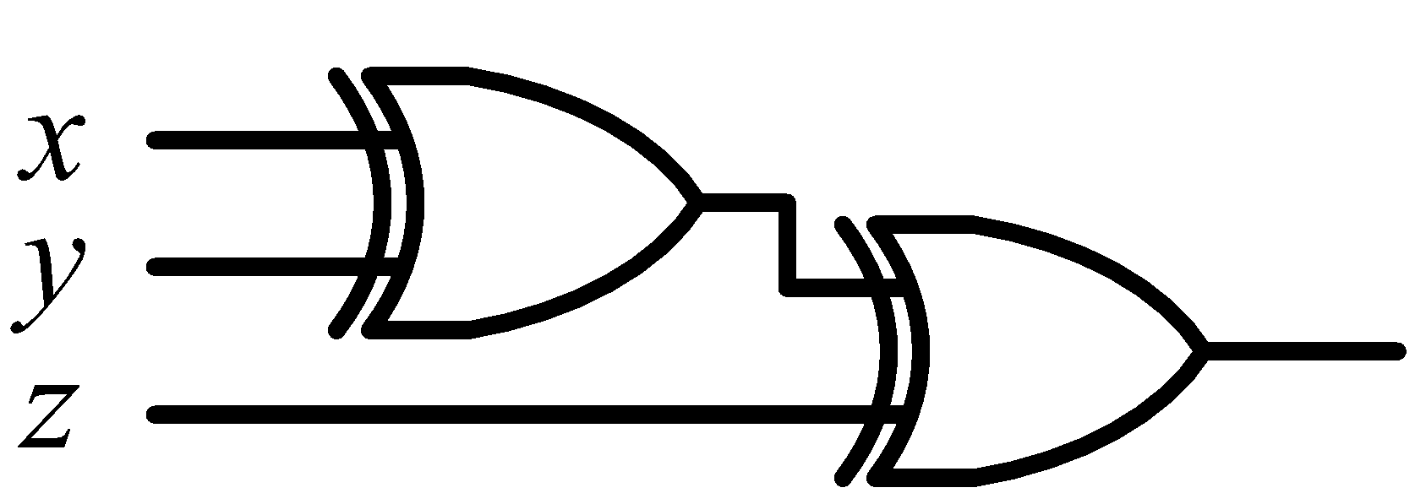
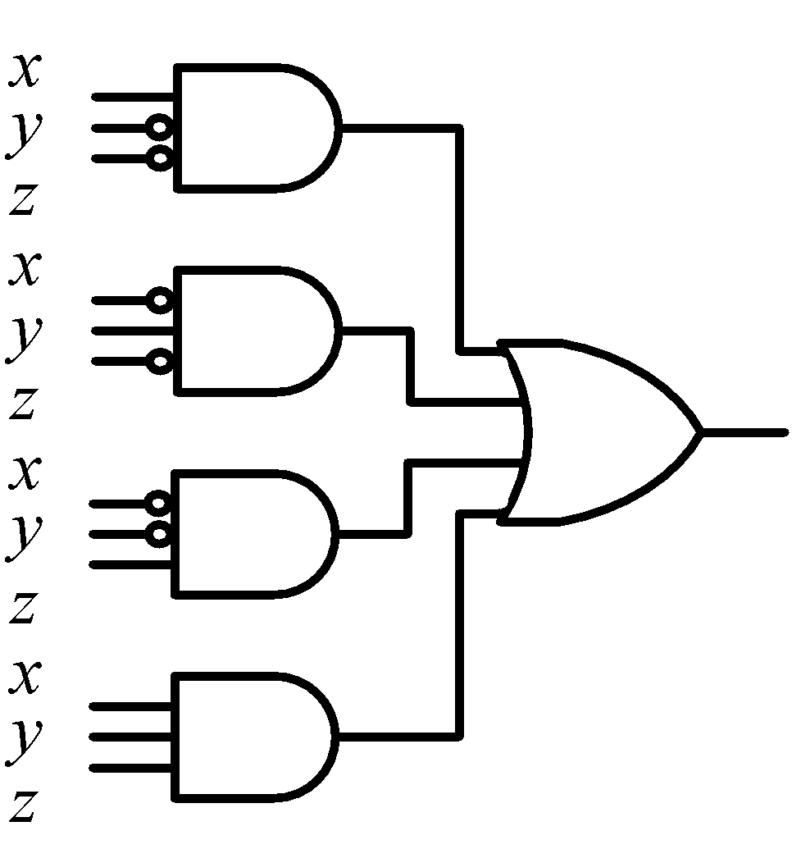
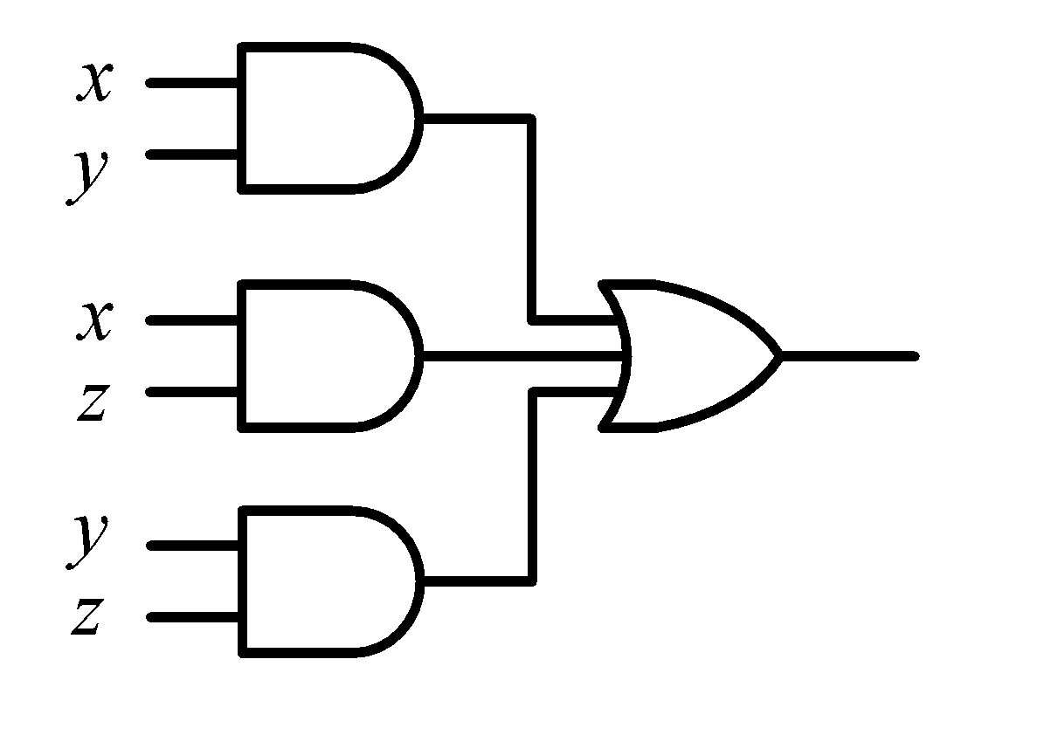

Binary Adder
Full Adder
S = xy'z'+x'yz'+x'y'z+xyz = x ⊕ y ⊕ z
C = xy + xz + yz
x
y
z
S
C
S
C
x
y
z

Slide 7
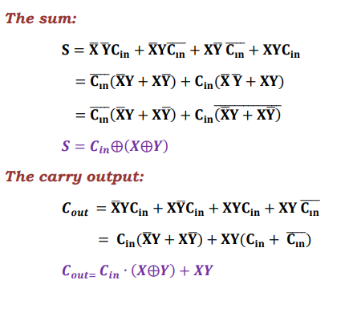
Binary Adder
Full adder design from two half adder

Slide 8
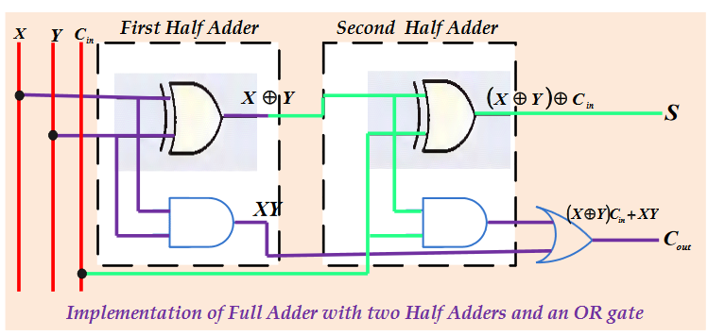

Binary Adder
Full Adder
HA
HA
x
y
z
S
C

Slide 9
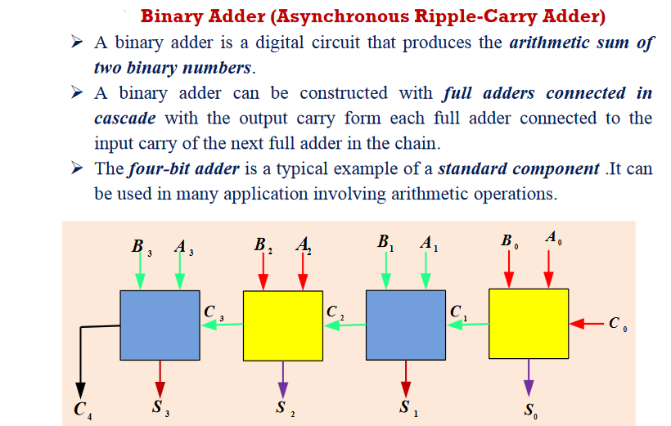
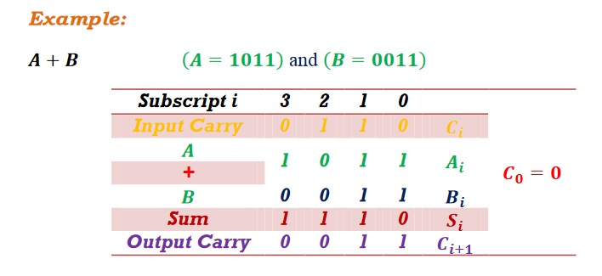
Binary Adder
c₃ c₂ c₁ .
+ x₃ x₂ x₁ x₀
+ y₃ y₂ y₁ y₀
────────
Cy S₃ S₂ S₁ S₀

Slide 10
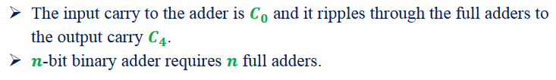
Binary Adder
x₃x₂x₁x₀ y₃y₂y₁y₀
Binary Adder
C_{y}
C₀
S₃S₂S₁S₀

Slide 11

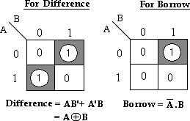
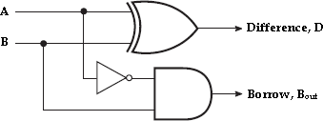
Binary Subtractor
Block schematic of half-subtractor
Logical expression
Truth table
Input |  | Output
A | B | Difference (D) | Borrow (Bout)
0 | 0 | 0 | 0
0 | 1 | 1 | 1
1 | 0 | 1 | 0
1 | 1 | 0 | 0
Logical design

Slide 12
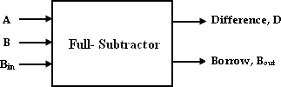
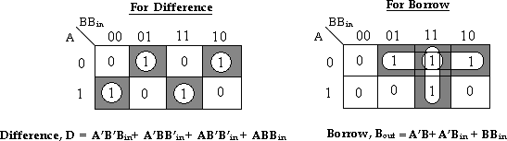
Binary Subtractor
Block schematic of full-subtractor
Truth table
Inputs |  |  | Outputs
A | B | Bin | Difference(D) | Borrow(Bout)
0 | 0 | 0 | 0 | 0
0 | 0 | 1 | 1 | 1
0 | 1 | 0 | 1 | 1
0 | 1 | 1 | 0 | 1
1 | 0 | 0 | 1 | 0
1 | 0 | 1 | 0 | 0
1 | 1 | 0 | 0 | 0
1 | 1 | 1 | 1 | 1
Logical expression

Slide 13
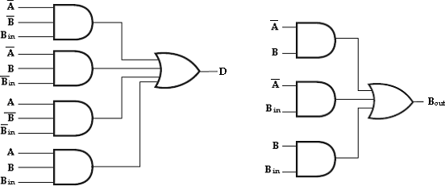
Binary Subtractor
Logical design

Slide 14
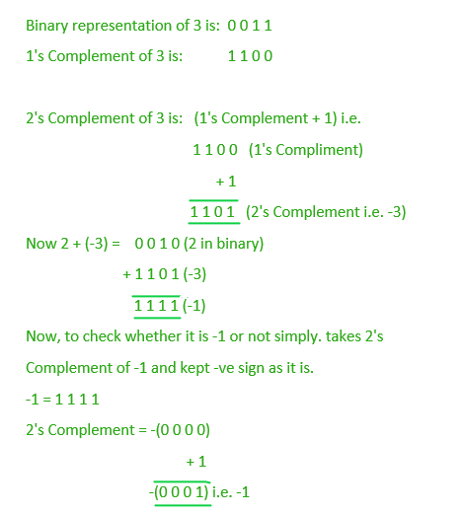
Binary Subtractor
1’s Complement of a Binary Number
There is a simple algorithm to convert a binary number into 1’s complement. To get 1’s complement of a binary number, simply invert the given number.
2’s Complement of a Binary Number
There is a simple algorithm to convert a binary number into 2’s complement. To get 2’s complement of a binary number, simply invert the given number and add 1 to the least significant bit (LSB) of given result.
Example

Slide 15
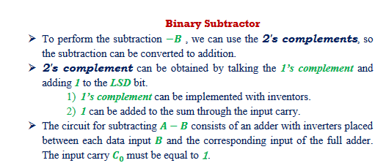
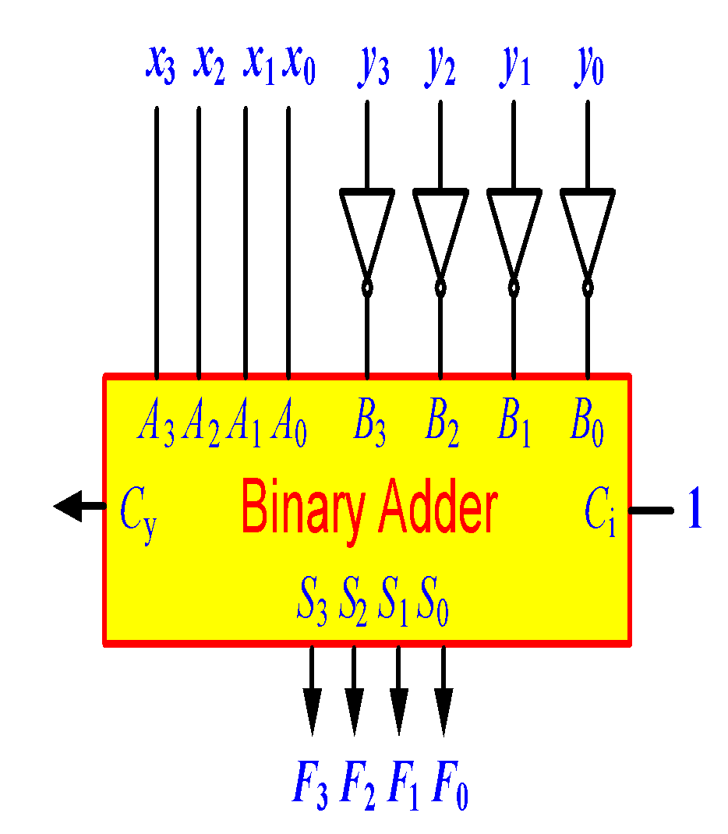
Binary Subtractor
Use 2’s complement with binary adder
x – y = x + (-y) = x + y’ + 1

Slide 16
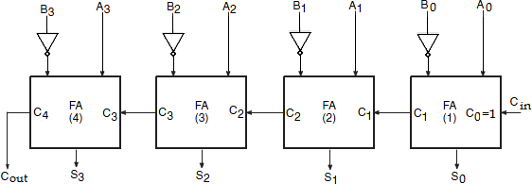
Binary Subtractor

Slide 17
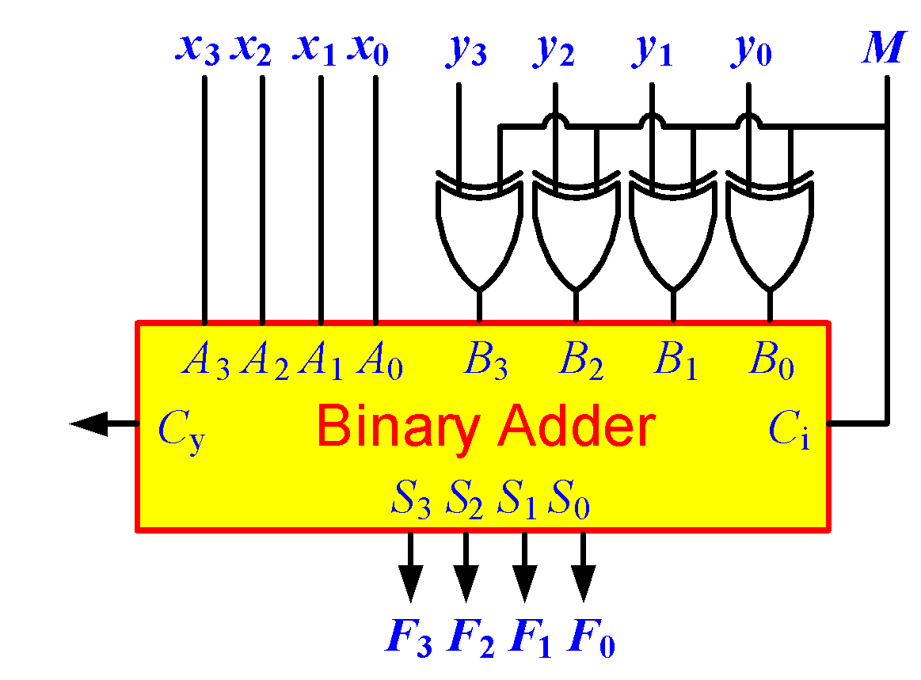
Binary Adder/Subtractor
M: Control Signal (Mode)
M=0 🡺 F = x + y
M=1 🡺 F = x – y

Slide 18
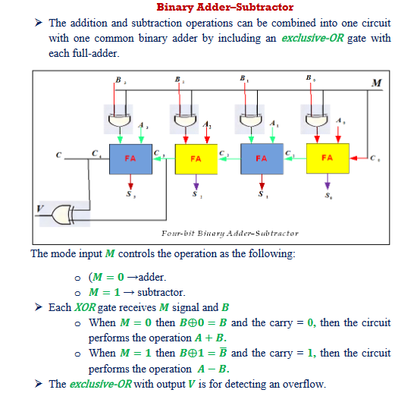
Binary Subtractor

Slide 19
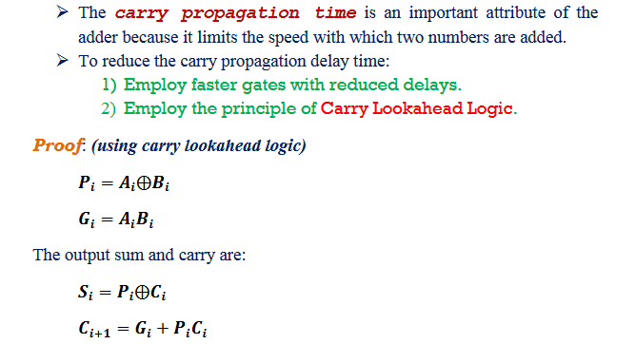
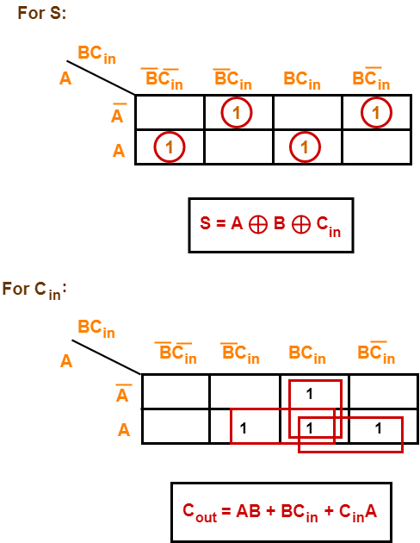
Carry look ahead Adder
Full adder equation
AB+ (A XOR B)C

Slide 20
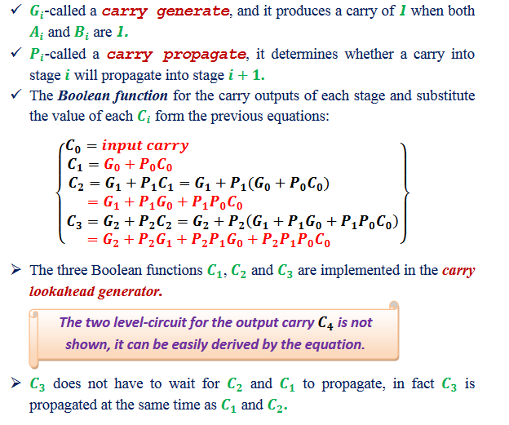
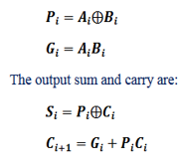
Carry look ahead Adder

Slide 21
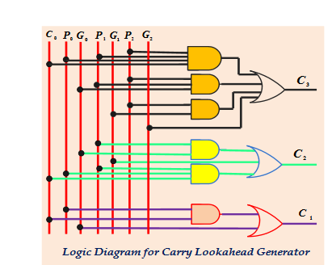
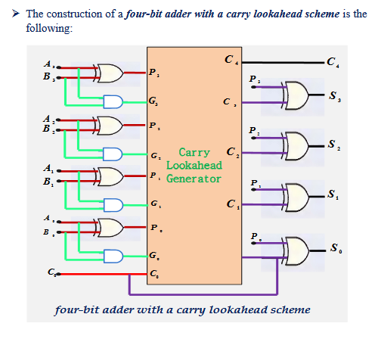
Carry look ahead Adder

Slide 22
Decimal Adder
A decimal adder requires a minimum of 9 inputs and 5 outputs
1 digit requires 4-bit
Input: 2 digits + 1-bit carry
Output: 1 digit + 1-bit carry
BCD adder
Perform the addition of two decimal digits in BCD, together with an input
carry from a previous stage.
The output sum cannot be greater than 19 (9+9+1)

Slide 23
BCD Adder
4-bits plus 4-bits
Operands and Result: 0 to 9
+ x₃ x₂ x₁ x₀
+ y₃ y₂ y₁ y₀
────────
Cy S₃ S₂ S₁ S₀
X +Y | x₃ x₂ x₁ x₀ | y₃ y₂ y₁ y₀ | Sum | Cy | S₃ S₂ S₁ S₀
0 + 0 | 0 0 0 0 | 0 0 0 0 | = 0 | 0 | 0 0 0 0
0 + 1 | 0 0 0 0 | 0 0 0 1 | = 1 | 0 | 0 0 0 1
0 + 2 | 0 0 0 0 | 0 0 1 0 | = 2 | 0 | 0 0 1 0
0 + 9 | 0 0 0 0 | 1 0 0 1 | = 9 | 0 | 1 0 0 1
1 + 0 | 0 0 0 1 | 0 0 0 0 | = 1 | 0 | 0 0 0 1
1 + 1 | 0 0 0 1 | 0 0 0 1 | = 2 | 0 | 0 0 1 0
1 + 8 | 0 0 0 1 | 1 0 0 0 | = 9 | 0 | 1 0 0 1
1 + 9 | 0 0 0 1 | 1 0 0 1 | = A | 0 | 1 0 1 0
Invalid Code
2 + 0 | 0 0 1 0 | 0 0 0 0 | = 2 | 0 | 0 0 1 0
9 + 9 | 1 0 0 1 | 1 0 0 1 | = 12 | 1 | 0 0 1 0
Wrong BCD Value
0001 1000

Slide 24
BCD Adder
X +Y | x₃ x₂ x₁ x₀ | y₃ y₂ y₁ y₀ | Sum | Cy | S₃ S₂ S₁ S₀ | Required BCD Output | Value
9 + 0 | 1 0 0 1 | 0 0 0 0 | = 9 | 0 | 1 0 0 1 | 0 0 0 0 1 0 0 1 | = 9
9 + 1 | 1 0 0 1 | 0 0 0 1 | = 10 | 0 | 1 0 1 0 | 0 0 0 1 0 0 0 0 | = 16
9 + 2 | 1 0 0 1 | 0 0 1 0 | = 11 | 0 | 1 0 1 1 | 0 0 0 1 0 0 0 1 | = 17
9 + 3 | 1 0 0 1 | 0 0 1 1 | = 12 | 0 | 1 1 0 0 | 0 0 0 1 0 0 1 0 | = 18
9 + 4 | 1 0 0 1 | 0 1 0 0 | = 13 | 0 | 1 1 0 1 | 0 0 0 1 0 0 1 1 | = 19
9 + 5 | 1 0 0 1 | 0 1 0 1 | = 14 | 0 | 1 1 1 0 | 0 0 0 1 0 1 0 0 | = 20
9 + 6 | 1 0 0 1 | 0 1 1 0 | = 15 | 0 | 1 1 1 1 | 0 0 0 1 0 1 0 1 | = 21
9 + 7 | 1 0 0 1 | 0 1 1 1 | = 16 | 1 | 0 0 0 0 | 0 0 0 1 0 1 1 0 | = 22
9 + 8 | 1 0 0 1 | 1 0 0 0 | = 17 | 1 | 0 0 0 1 | 0 0 0 1 0 1 1 1 | = 23
9 + 9 | 1 0 0 1 | 1 0 0 1 | = 18 | 1 | 0 0 1 0 | 0 0 0 1 1 0 0 0 | = 24
🗶
🗶
🗶
🗶
🗶
🗶
🗶
🗶
🗶
+ 6

Slide 25
BCD Adder
Correct Binary Adder’s Output (+6)
If the result is between ‘A’ and ‘F’
If Cy = 1
S₃ S₂ S₁ S₀ | y1
0 0 0 0 | 0
1 0 0 0 | 0
1 0 0 1 | 0
1 0 1 0 | 1
1 0 1 1 | 1
1 1 0 0 | 1
1 1 0 1 | 1
1 1 1 0 | 1
1 1 1 1 | 1
 |  |  |  | S₁
 |  |  |  |  |  | S₂
S₃ |  | 1 | 1 | 1 | 1
 |  |  |  | 1 | 1
 |  |  | S₀
Err = S₃ S₂ + S₃ S₁

Slide 26
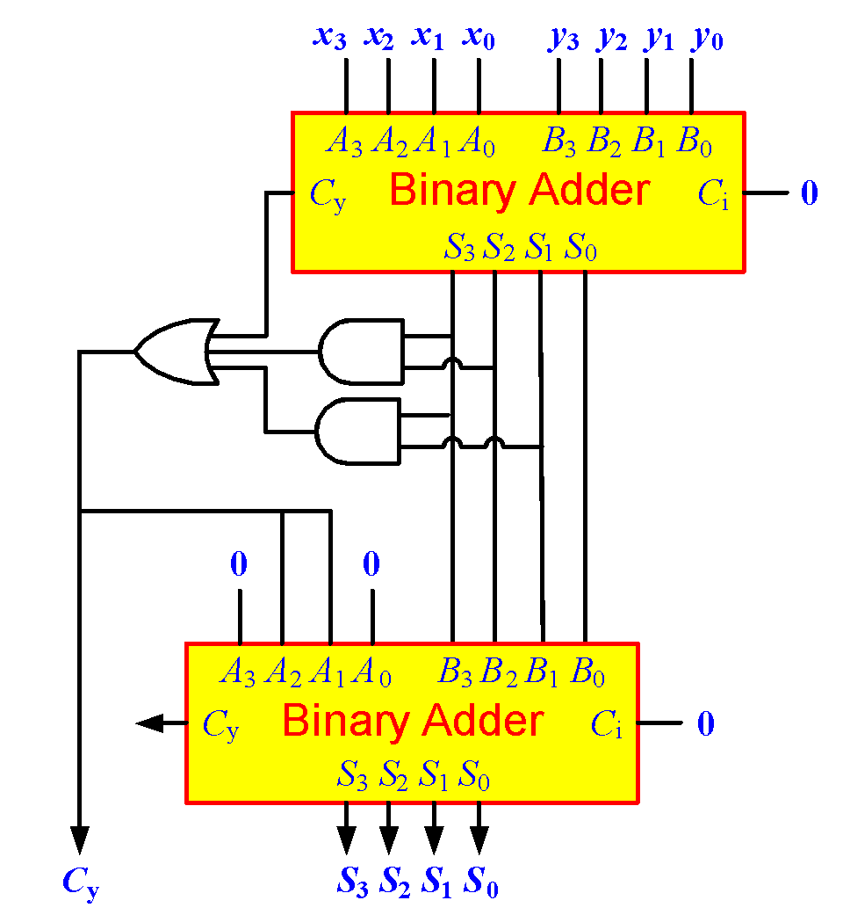
BCD Adder
Err

Slide 27
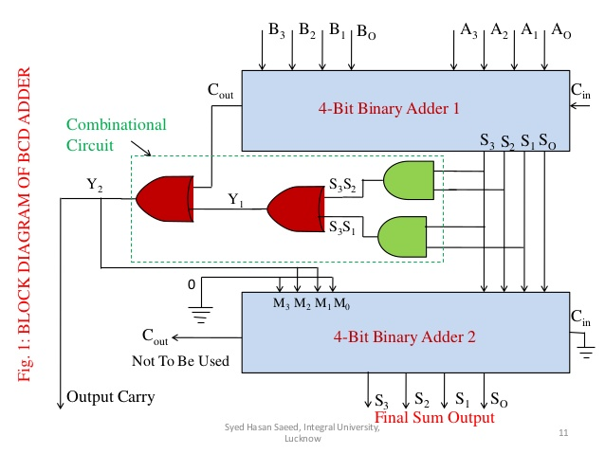
BCD Adder

Slide 28

Overflow
Unsigned Binary Numbers
2’s Complement Numbers
x₃ x₂ x₁ x₀
y₃ y₂ y₁ y₀
0
FA
FA
FA
FA
Carry
C₄ C₃ C₂ C₁
S₃ S₂ S₁ S₀
x₃ x₂ x₁ x₀
y₃ y₂ y₁ y₀
0
FA
FA
FA
FA
Overflow
C₄ C₃ C₂ C₁
S₃ S₂ S₁ S₀

Slide 29
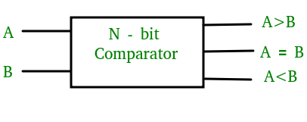
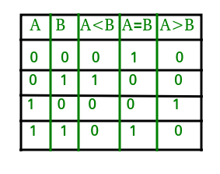
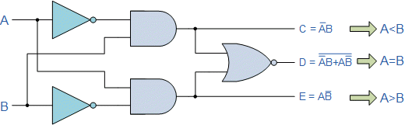
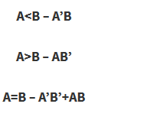
Magnitude Comparator
1- Bit magnitude comparator
A comparator used to compare two bits is called a single bit comparator.
It consists of two inputs each for two single bit numbers and three outputs to generate less than, equal to and greater than between two binary numbers.
Truth table
Logic design
Equation from truth table

Slide 30
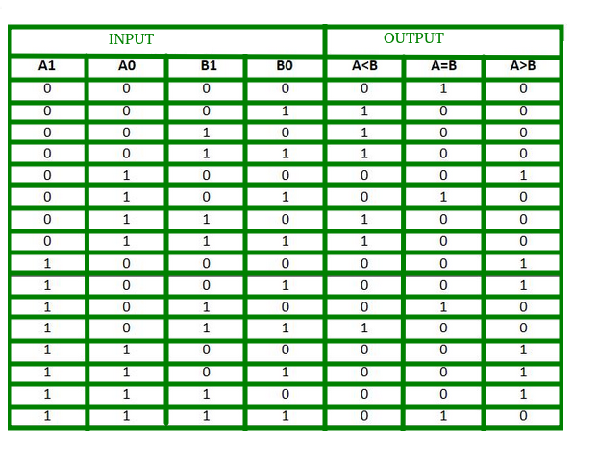
Magnitude Comparator
2- Bit magnitude comparator
A comparator used to compare two binary numbers each of two bits is called a 2-bit Magnitude comparator. It consists of four inputs and three outputs to generate less than, equal to and greater than between two binary numbers.
Truth table

Slide 31
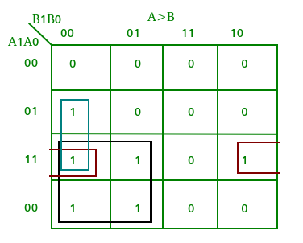
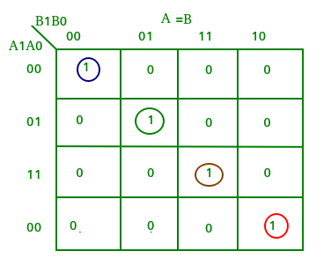
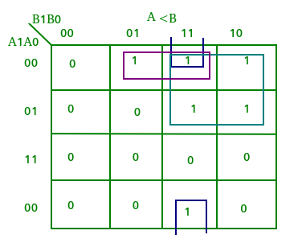
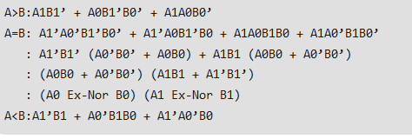
K map for 2- Bit magnitude comparator
Design equations

Slide 32
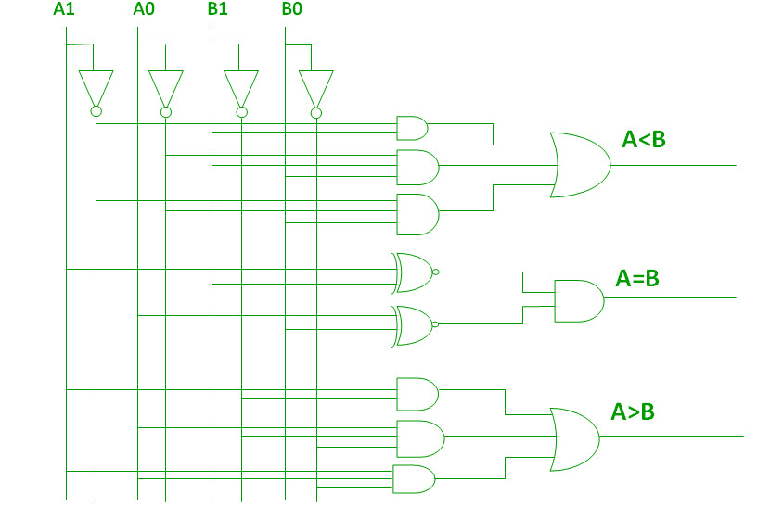
Logic design of 2 –bit magnitude comparator

